Slide 2
Title IX and Sexual Misconduct

Slide 3
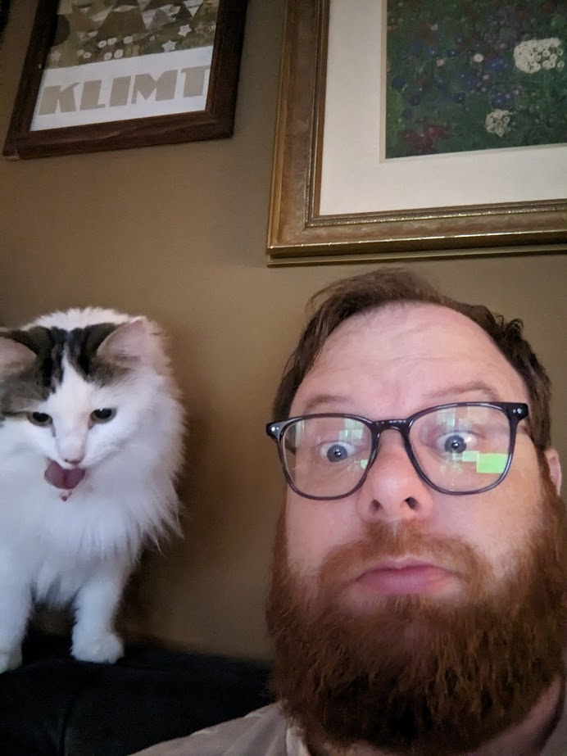
Who am I?
John Perrin
Director of Equal Opportunity
& Title IX Compliance
SLO 213
(859) 238-5881
John.Perrin@Centre.edu

Slide 4
Content Notice
At times, it is necessary to address subjects that could potentially cause discomfort, distress, or activate emotional responses. Please take care of yourself during our discussion.
Grounding Techniques:
Deep Breathing: Take slow, deep breaths, focusing on the sensation of the air entering and leaving your body.
5-4-3-2-1 Technique: Look around your environment and identify five things you can see, four things you can touch, three things you can hear, two things you can smell, and one thing you can taste.
Mindful Observation: Choose an object in your surroundings and examine it closely. Notice its shape, color, texture, and any other details. Engage your senses by observing its smell, sound, or taste if appropriate.
Touch: Engage in activities that involve touch, such as squeezing a stress ball, holding a comforting object, or rubbing your fingertips together.

Slide 5
Goals of Understanding
What is Title IX?
Consent
Report and Complaint Process
How to help a friend
Know your resources

Slide 6
Your Rights
All members of the Centre College community, have the right to be free from sexual harassment, violence, and discrimination. All members of the University community are expected to conduct themselves in a manner that does not infringe upon the rights of others.

Slide 7
What is Title IX?
“No person in the United States shall, on the basis of sex, be excluded from participation in, be denied the benefits of, or be subjected to discrimination under any education program or activity receiving Federal financial assistance.”
Title IX covers:
Sex Discrimination
Sexual Misconduct
Pregnancy Discrimination

Slide 8
Prohibited Conduct
Sexual Harassment
Sexual Assault
Stalking
Relationship Violence

Slide 9
Sexual Harassment
Visual, verbal (spoken or written), or physical behavior directed at someone because of that person’s actual or perceived sex, gender, gender identity, gender expression, or sexual orientation.
Visual
Pictures, sending or posting sexual photos, posters
Verbal
Making comments about someone’s body, repeatedly asking someone out, jokes about sex
Physical
Touching, blocking someone’s path, hugging or kissing

Slide 10
Sexual Assault
Sexual Assault
Non-consensual Penetration
Rape
Non-consensual Touching
Fondling

Slide 11
Stalking
A course of conduct directed at a specific person that causes a reasonable person to fear for their safety or suffer substantial emotional distress. This can include:
Following someone around campus
Waiting outside someone’s class or residence hall
Sending unwanted letters or gifts
Repeated calling/texting/messaging

Slide 12
Relationship Violence
Dating/Domestic/Intimate Partner Violence
Does NOT HAVE to be physical violence:
Stalking
Economic abuse
Psychological or emotional abuse

Slide 13
Toxic Relationships
Toxic does not equal abusive
BUT
Watch for signs of abuse.

Slide 14
Retaliation
“…act or attempt to retaliate, intimidate, or seek retribution against anyone involved in or connected to reporting a concern, the investigation of, and/or the resolution of a sexual misconduct allegation…
…retaliation also includes filing charges against a person for code of conduct charges that arise out of the same facts and circumstances, but do not involve sex discrimination or sexual harassment, for the purpose of interfering with any right or privilege…”

Slide 15
Understanding Consent
Mutually understandable
Words or actions of the parties
Understandable agreement between them to do the same thing, in the same way, at the same time and with one another

Slide 16
Understanding Consent
Absence of a verbally stated “no”, silence without actions demonstrating permission, cannot be assumed to show consent;
Never final or irrevocable;
Time-limited and situation-specific;
Can only be given by someone who is free from verbal or physical pressure, coercion, intimidation, threat, or force; and
Can only be given by someone in an unimpaired state of mind who is able to understand what is happening.

Slide 17
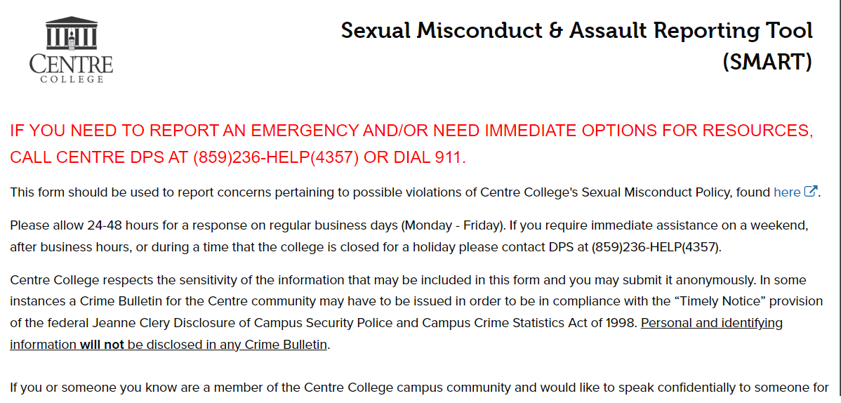
Reporting
SMART: Sexual Misconduct & Assault Reporting Tool

Slide 18
Mandatory Reporters
Who is a mandatory reporter?
Faculty
Staff
Administrators
Athletics Staff
RAs
Exceptions
Counseling Center
Student Health
College Chaplain

Slide 19
Myths About Reporting
Reporting means action will immediately be taken by the Title IX Office.
Support is not available unless you make a formal complaint.
The person will be immediately kicked off the team or out of school for reporting.
You will be forced to go to counseling or talk to law enforcement.

Slide 20
What Happens After a Report?
Report
Resources, options
Options
Informal
Title IX Coordinator may move ahead if safety risk to campus
Investigation
Investigation
Hearing
Summary report provided to parties
Notice of outcome sent to parties
Appeal
Supportive measures
Evidence provided to parties for review
Investigator conducts interviews, gathers evidence

Slide 21
Supportive Measures
Determined on a case-by-case basis
Generally, cannot be punitive
May include:
Counseling
Mutual restrictions on contact between the parties
Extensions of deadlines or other course-related adjustments
Modifications of work or class schedule
Changes in work locations
Leaves of absence

Slide 22
Types of Resolution
Formal Resolution
Informal Resolution
Resources & Assistance

Slide 23
What to do...
Are you okay?
Thank you for trusting me.
How can I help?
Direct to resources.
Continue to support.

Slide 24
What NOT to do…
Don’t ask questions to find out what happened. Just listen.
Deciding what happened, decide if it is worthy of believing
Discipline or action, such as talking to Respondent.
Making sure what happened isn’t just a rumor
Promise the actions that will be taken to correct the situation.

Slide 25
Confidential Resources
Counseling Center
Student Health
Office of Religious Life
Free and confidential.
A complete approach to wellness including physical and mental health issues.
Chaplain: Jason Crosby
Email: jason.crosby@centre.edu
Email:
Available by appointment when classes are in session. Same day appointments are available between 1:00 pm and 4:00 pm.
Email:
A Licensed Practical Nurse, a Registered Nurse, and a Physician’s Assistant are available during regular hours.
counseling@centre.edu
marsha.edelen@centre.edu

Slide 26
Non-Confidential Resources
John Perrin
Kendrick Durham
Ann Young
Title IX Coordinator john.perrin@centre.edu
Dean of Student Life kendrick.durham@centre.edu Roush Campus Center
Assistant Dean for Student Well-Being ann.young@centre.edu Nevin Hall
Roush Campus Center
Department of Public Safety
Office of Health Promotion
Other Mandatory Reporters
859-236-4357
Walnut House 1st Floor
859-236-5483
Roush Campus Center
Faculty
Staff
Administrators
Resident Advisors

Slide 27
External Resources
Danville Police Department
Ampersand
National Sexual Assault Hotline
911 in an Emergency
OR
859-238-1224
Sexual Violence Resource Center of the Bluegrass
859-253-2511
Available 24 Hours a Day
800-656-4673

Slide 28
Title IX and Pregnancy
Title IX protects against discrimination on the basis of:
Pregnancy
Childbirth
False Pregnancy
Termination of Pregnancy
Recovery from Pregnancy-related conditions
These conditions must be treated the same as any temporary disability for benefits and policy.

Slide 29
Title IX and Pregnancy
Institutions must provide accommodations for pregnancy!
Excused Absences due to pregnancy-related conditions
Breaks during class (restroom breaks, breastfeeding breaks)
Rescheduling tests or exams
A larger desk, access to elevators
Extension on deadlines or make-up assignments

Slide 30
Questions?
John Perrin, Title IX Coordinator
John.perrin@centre.edu
TitleIX@centre.edu
859-238-5881
Campus Center SLO 213

